Slide 2
AGENDA
What’s RxJS
Core concepts in RxJS
Operators and Pipe in RxJS

Slide 3

WHATS’S RXJS
“RxJS is a library for composing asynchronous and event-based programs by using observable sequences.” ——reactivex.io/rxjs

Slide 4
CORE CONCEPTS IN RXJS
Observable: represents the idea of an invokable collection of future values or events.
Observer: is a collection of callbacks that knows how to listen to values delivered by the Observable.
Subscription: represents the execution of an Observable, is primarily useful for cancelling the execution.
Operators: are pure functions that enable a functional programming style of dealing with collections with operations like map, filter, concat, reduce, etc.
Subject: is the equivalent to an EventEmitter, and the only way of multicasting a value or event to multiple Observers.
Schedulers: are centralized dispatchers to control concurrency, allowing us to coordinate when computation happens on e.g. setTimeout or requestAnimationFrame or others.

Slide 5
Observable
Observables are able to produce data either synchronously or asynchronously.

Slide 6
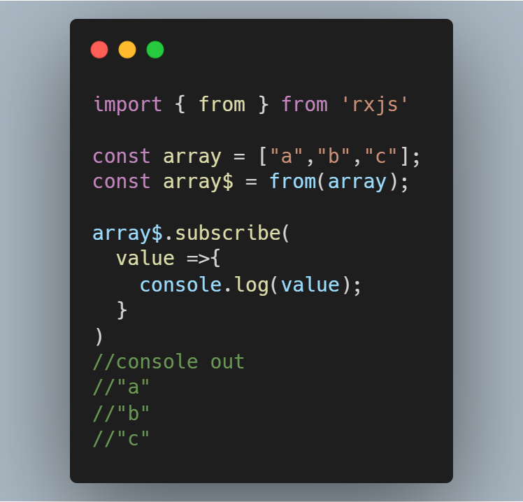
THE WAYS TO CREATE AN OBSERVABLE
from()
of()
fromEvent()
timer()
Interval()

Slide 7
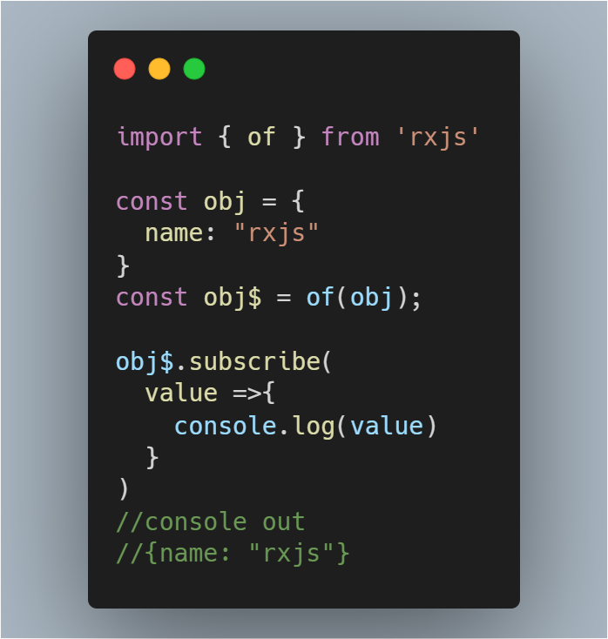
THE WAYS TO CREATE AN OBSERVABLE
from()
of()
fromEvent()
timer()
Interval()

Slide 8
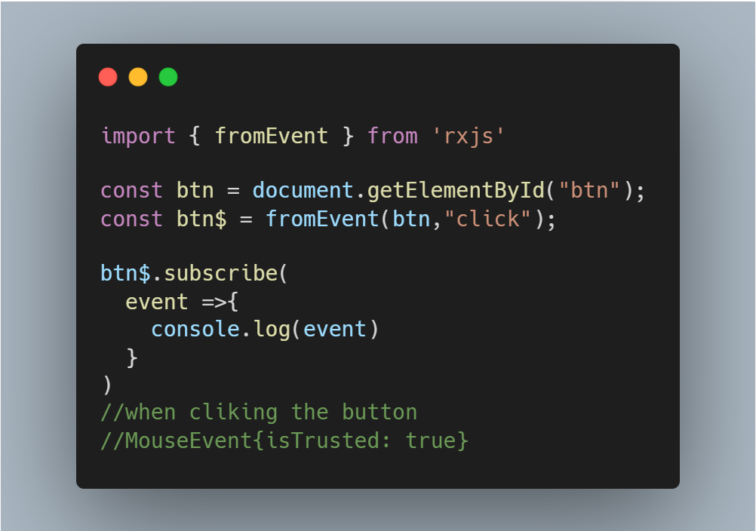
THE WAYS TO CREATE AN OBSERVABLE
from()
of()
fromEvent()
timer()
Interval()

Slide 9
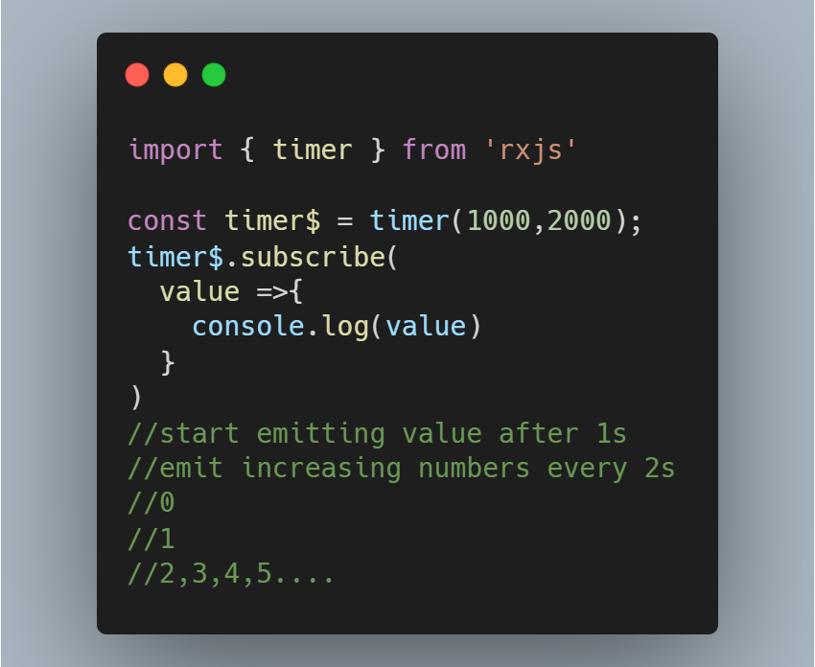
THE WAYS TO CREATE AN OBSERVABLE
from()
of()
fromEvent()
timer()
Interval()

Slide 10
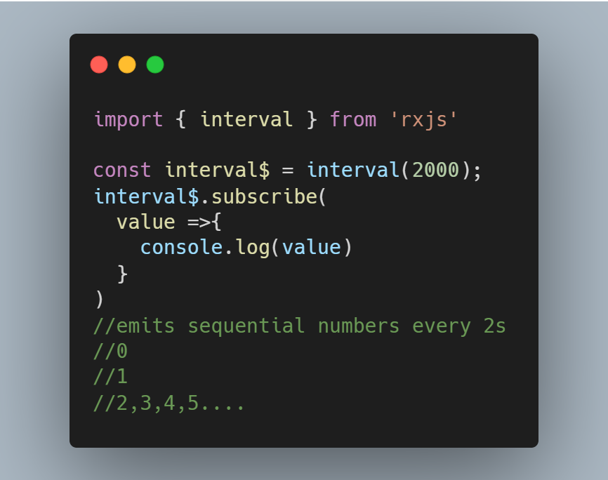
THE WAYS TO CREATE AN OBSERVABLE
from()
of()
fromEvent()
timer()
Interval()

Slide 11
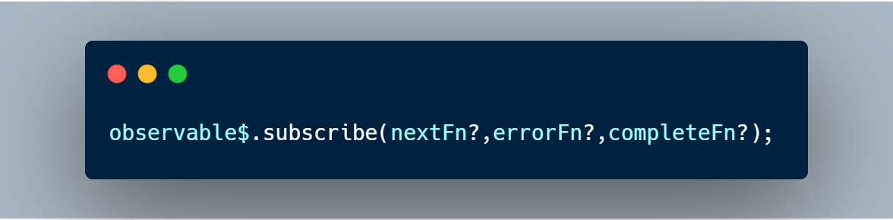
Subscribing to Observables
The observable’s subscribe method allows you to pass three callback methods as parameters.
Whenever the data arrives, the nextFn will be invoked to process the data.
Before the data arrives if an exception happens, the errorFn will be invoked to handle the error.
When all the data has been emitted successfully, the completeFn will be invoked.
If error occurred, the afterwards data will not be delivered and the completeFn will be not invoked.

Slide 12
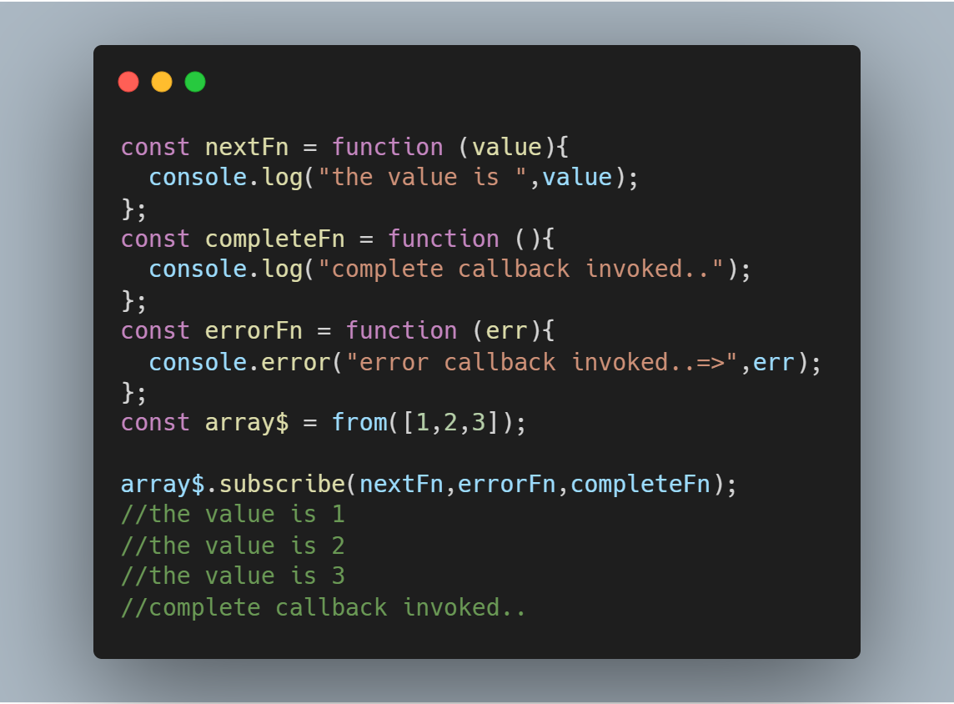
Subscribing to Observables

Slide 13
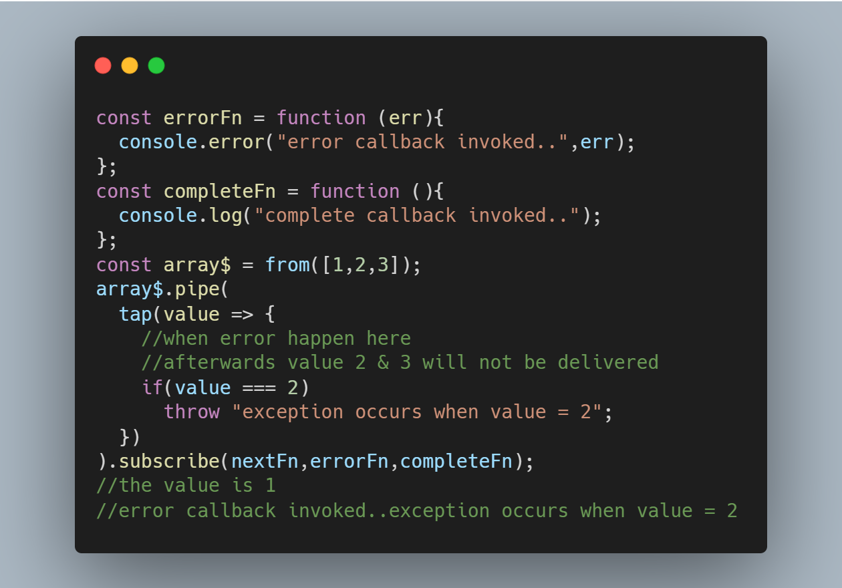
Subscribing to Observables

Slide 14
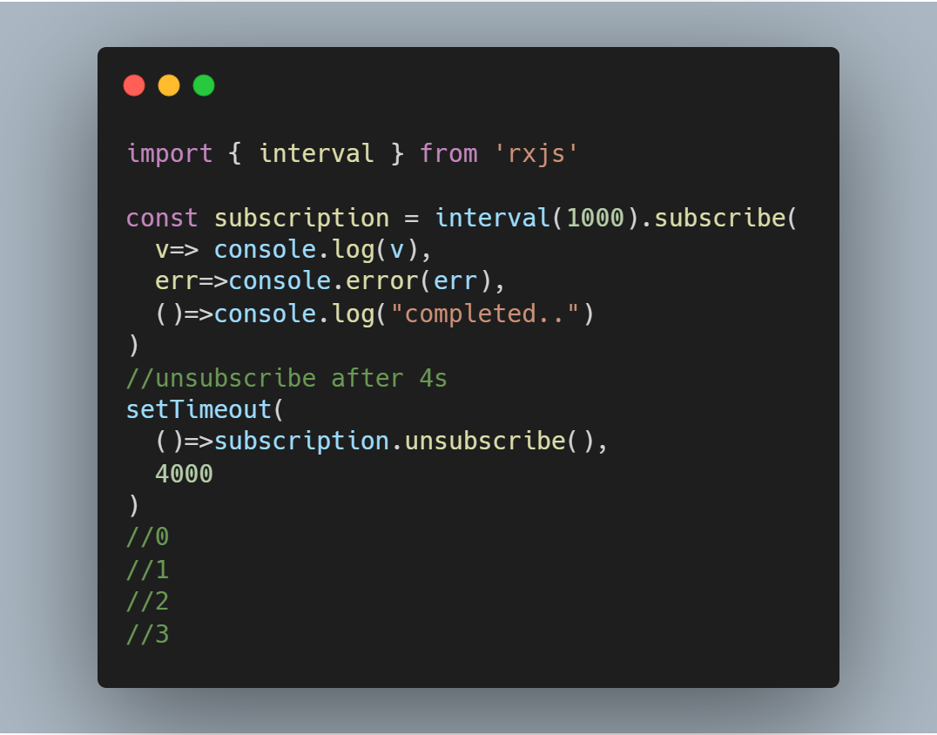
What is a Subscription?
A Subscription is an object that represents the execution of an Observable.
A Subscription has an unsubscribe() function to release resources or cancel Observable executions.

Slide 15
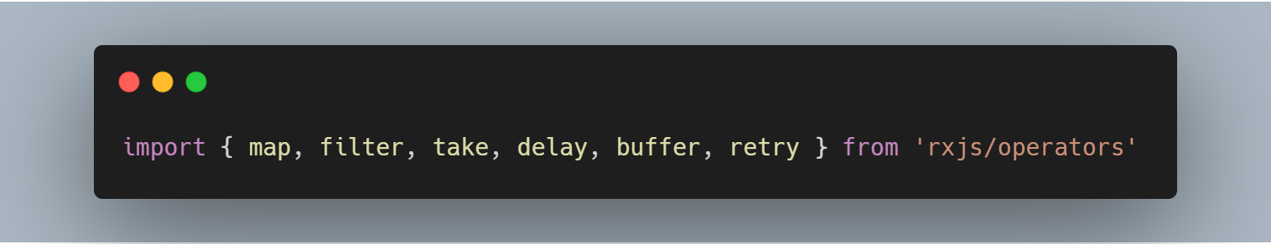
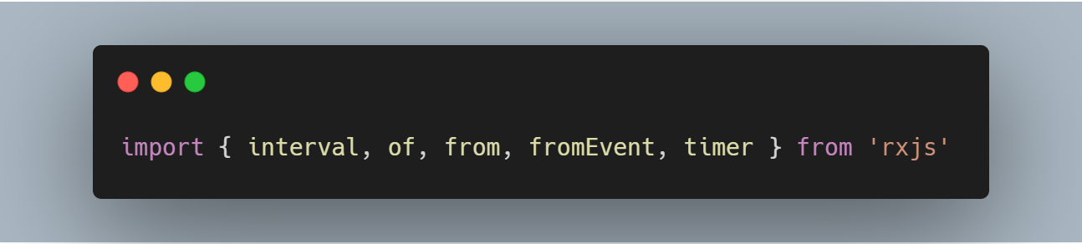
Operators
Pipeable Operator
Creation Operator

Slide 16
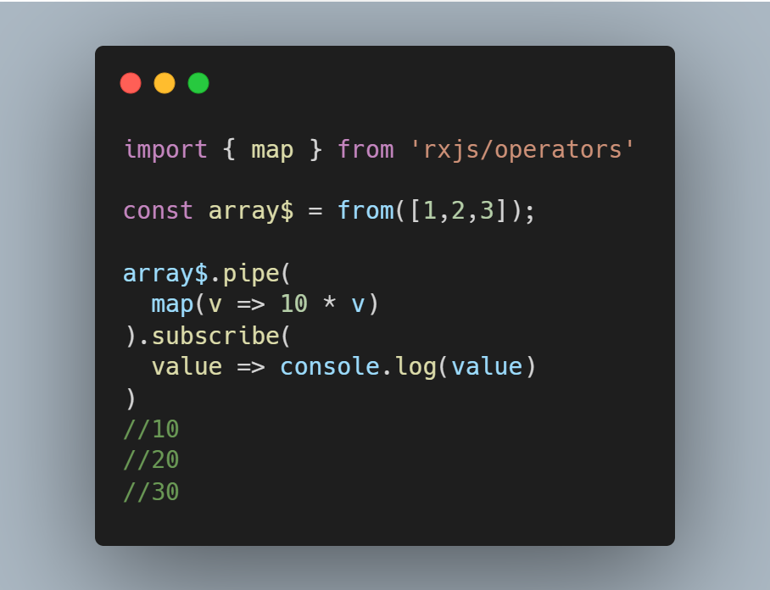
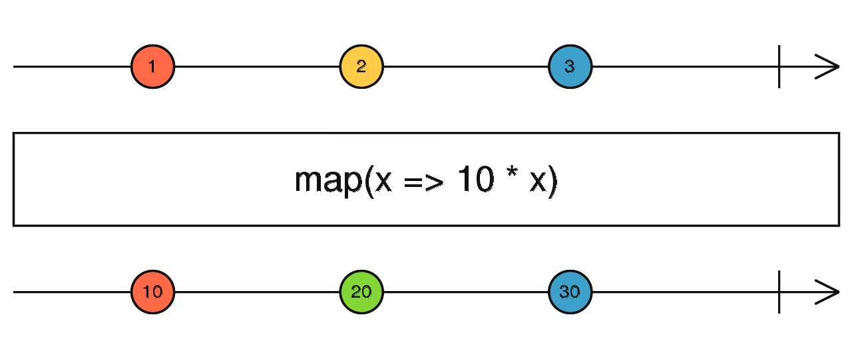
Operators
map()

Slide 17
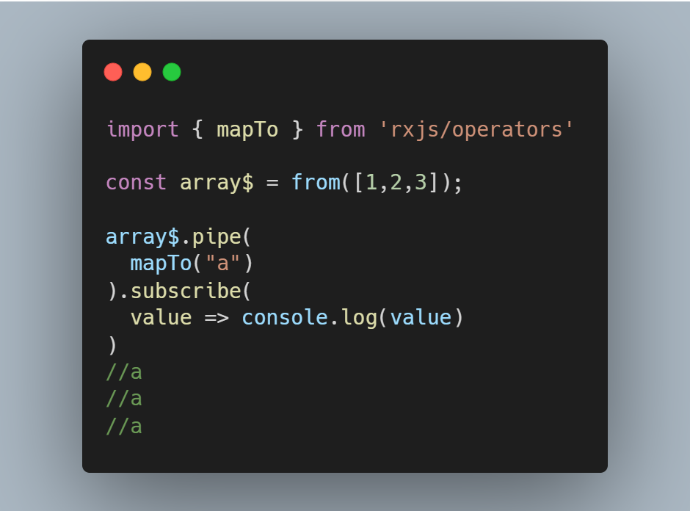
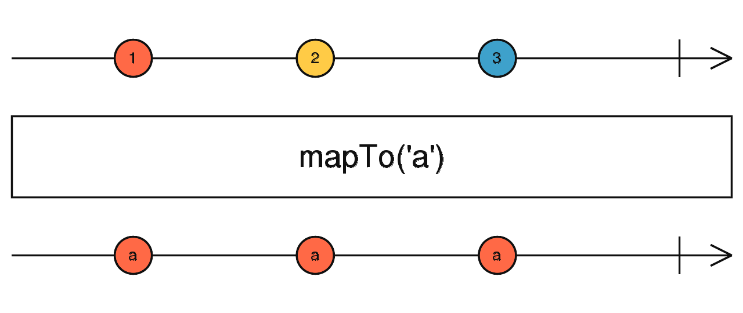
Operators
mapTo()

Slide 18
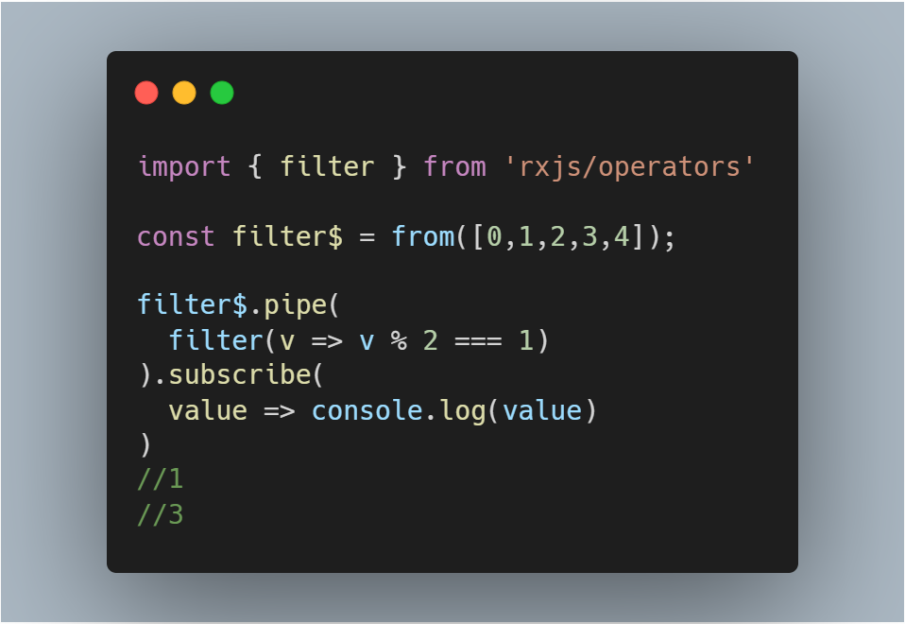
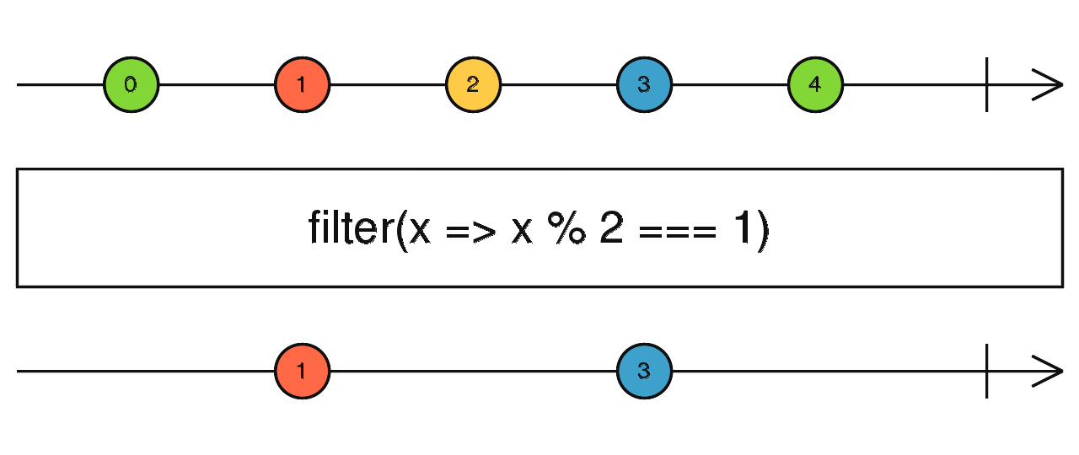
Operators
filter()

Slide 19
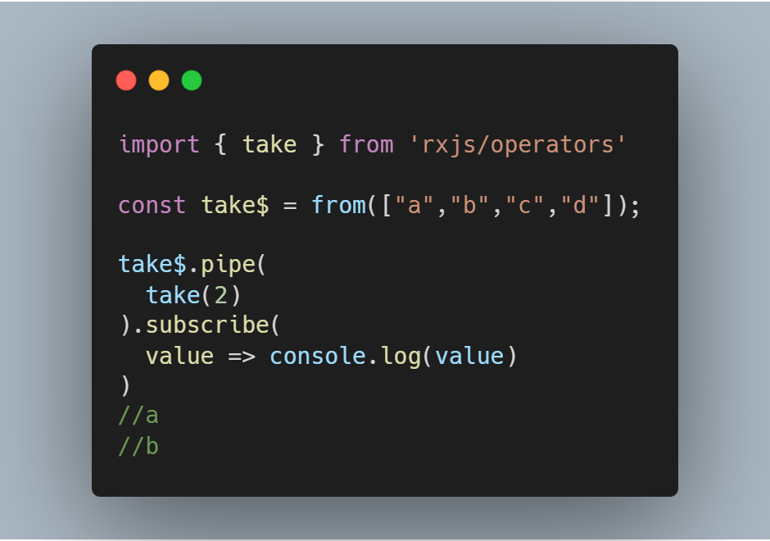
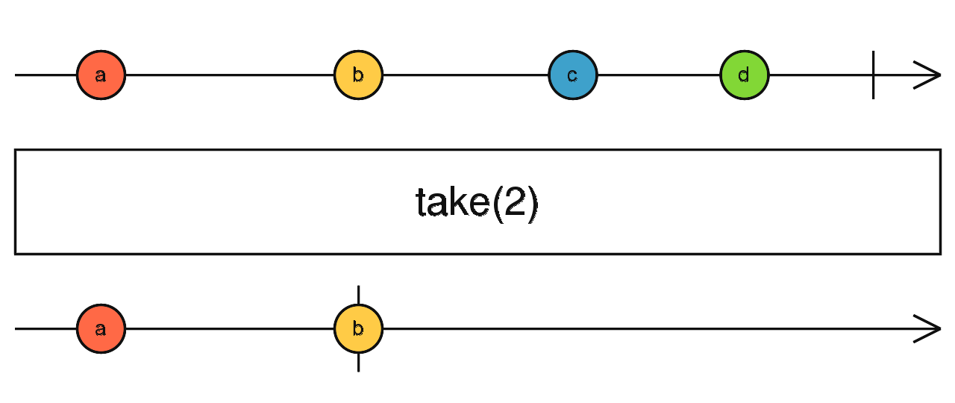
Operators
take()

Slide 20
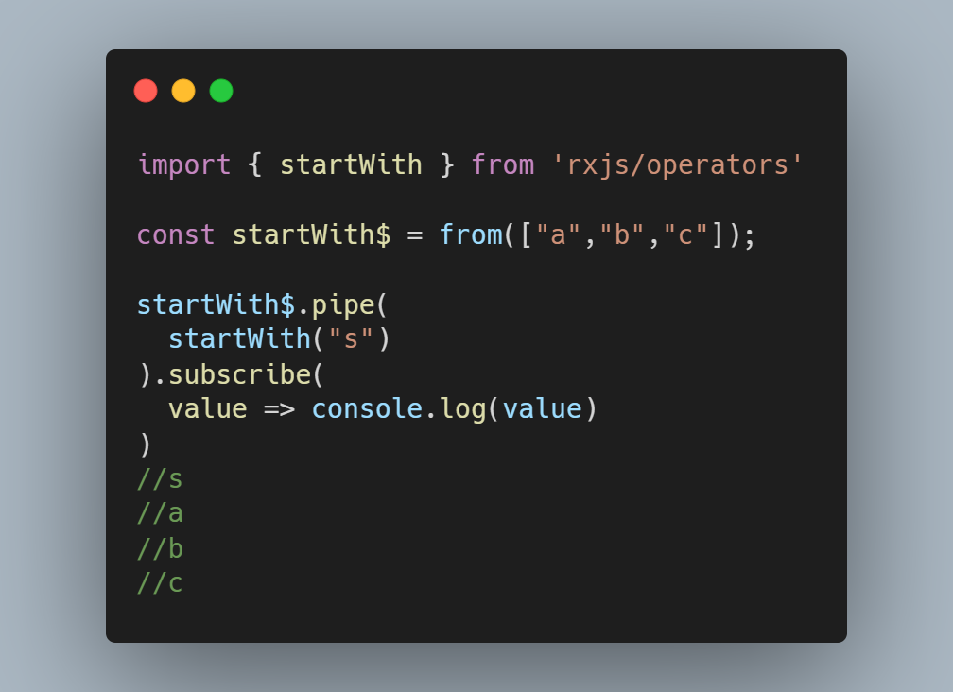
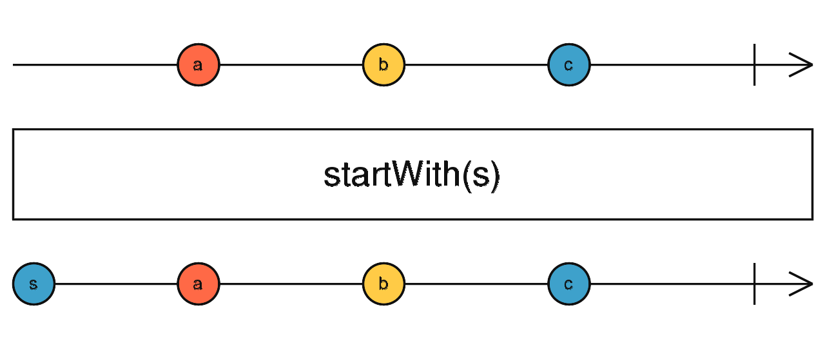
Operators
startWith()

Slide 21
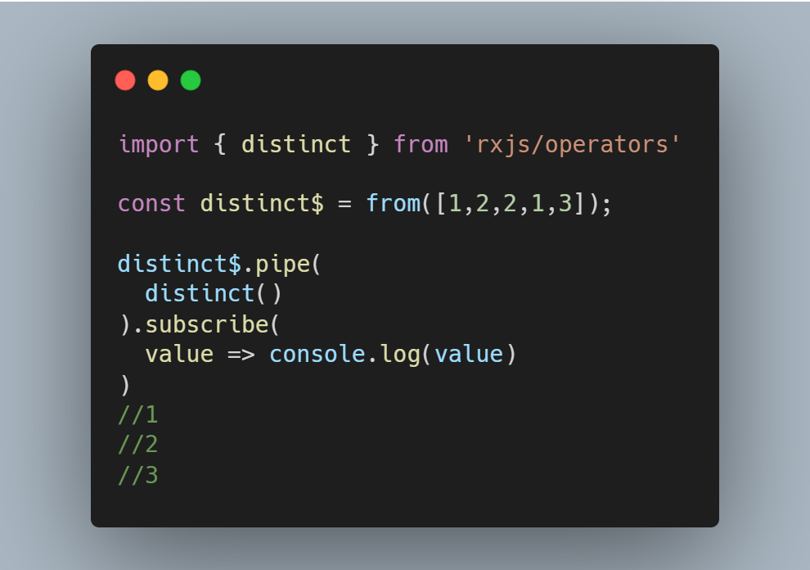
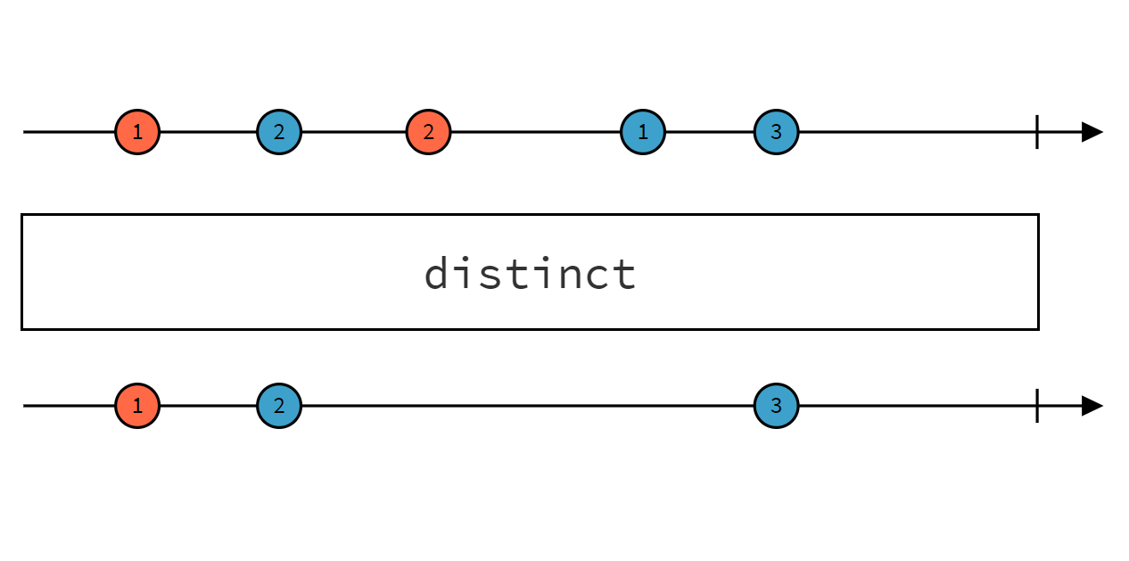
Operators
distinct()

Slide 22
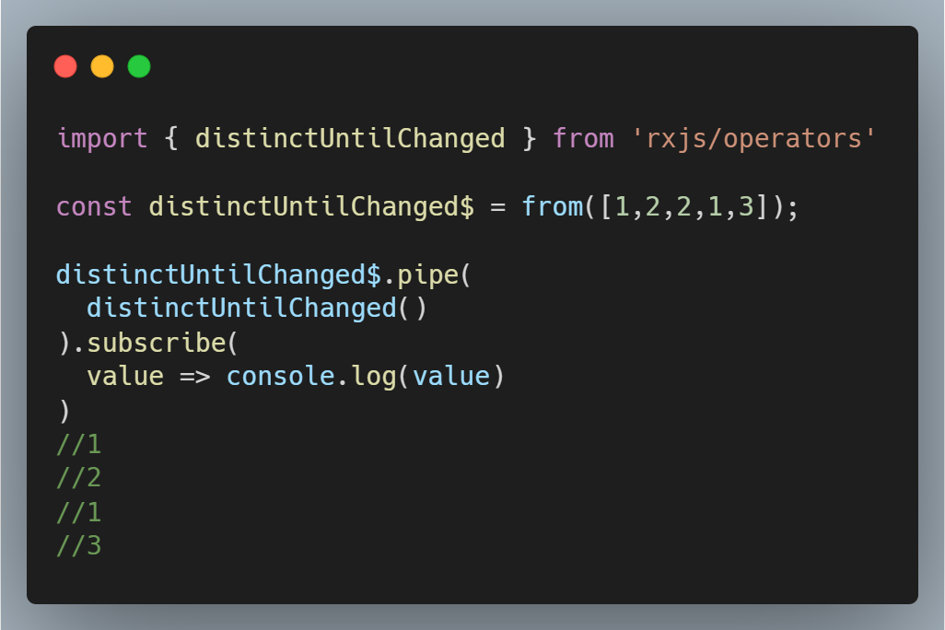
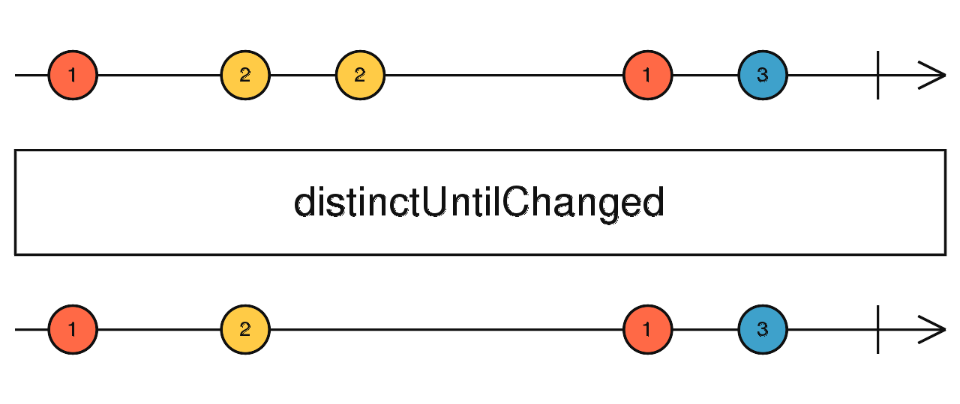
Operators
distinctUntilChanged()

Slide 23
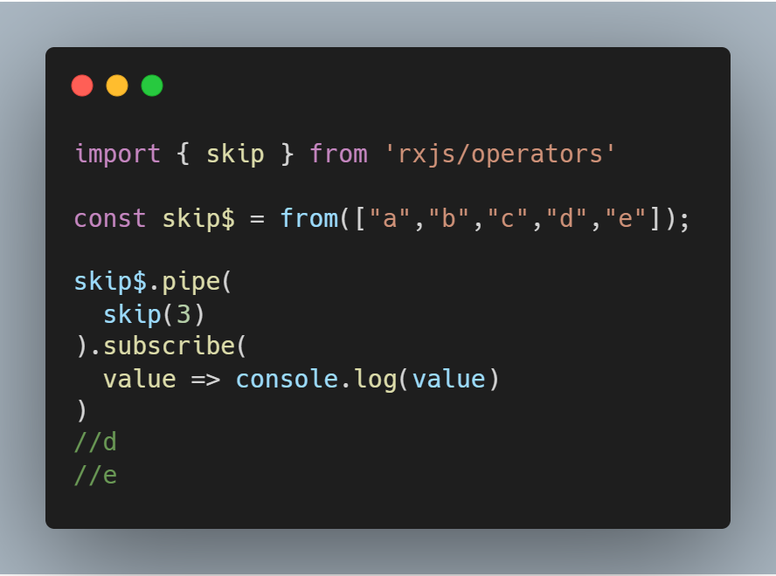
Operators
skip()

Slide 24
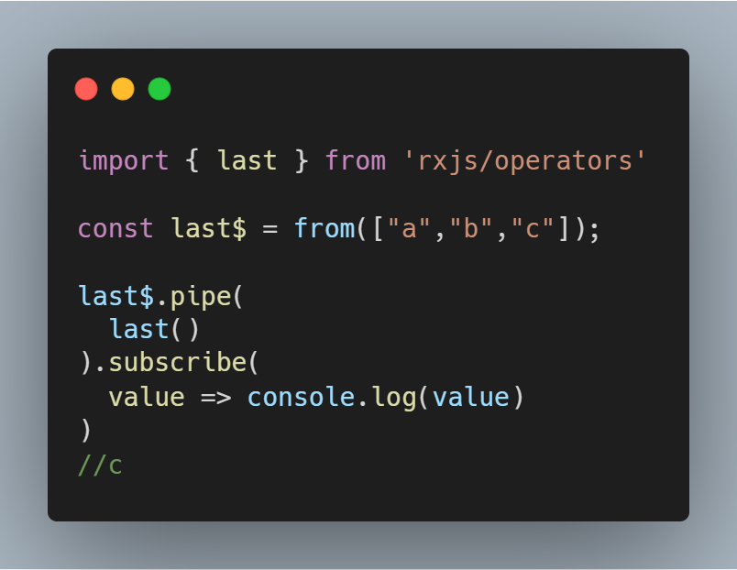
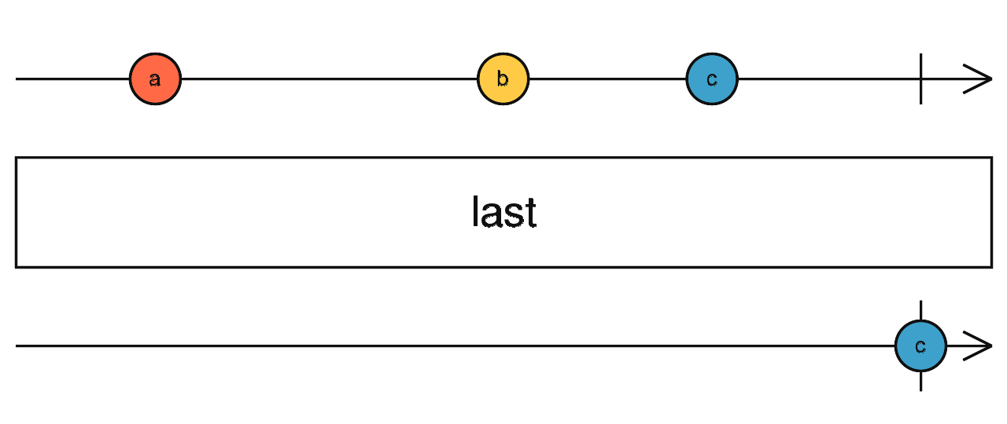
Operators
last()

Slide 25
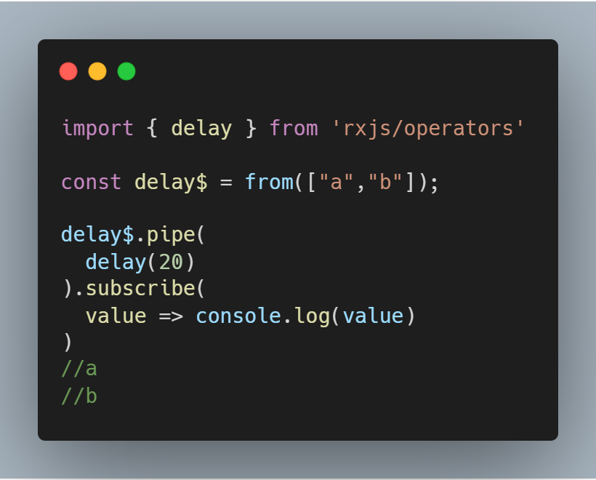
Operators
delay()

Slide 26
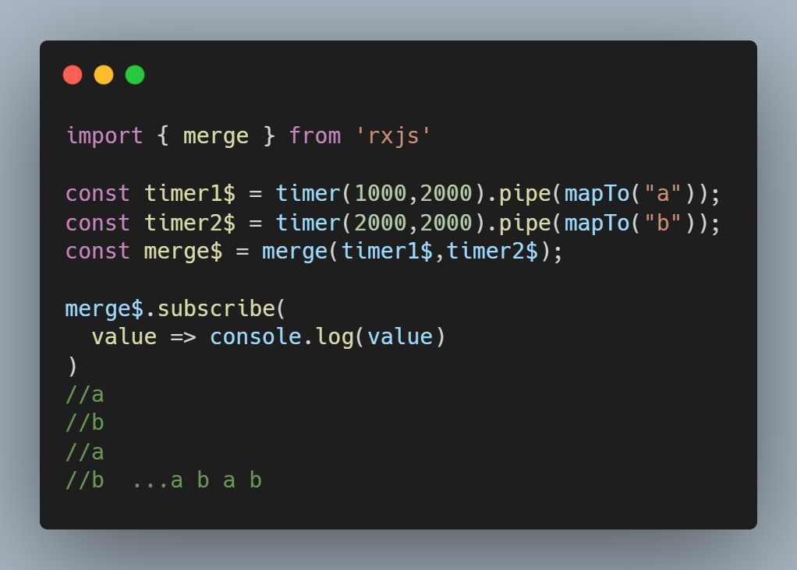
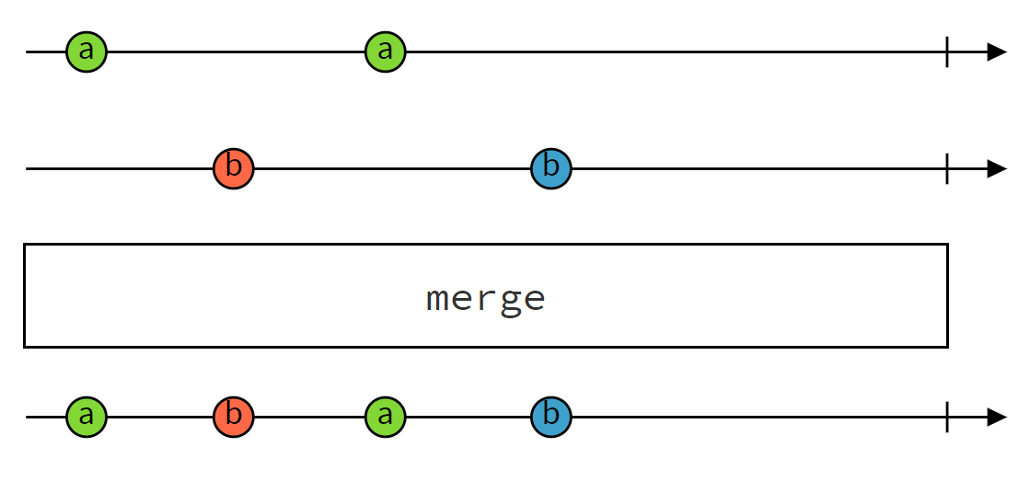
High-Level Operators
merge()

Slide 27
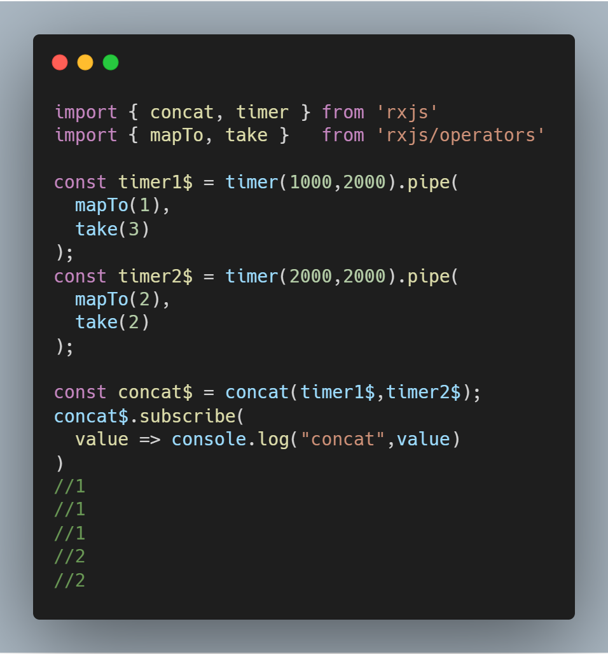
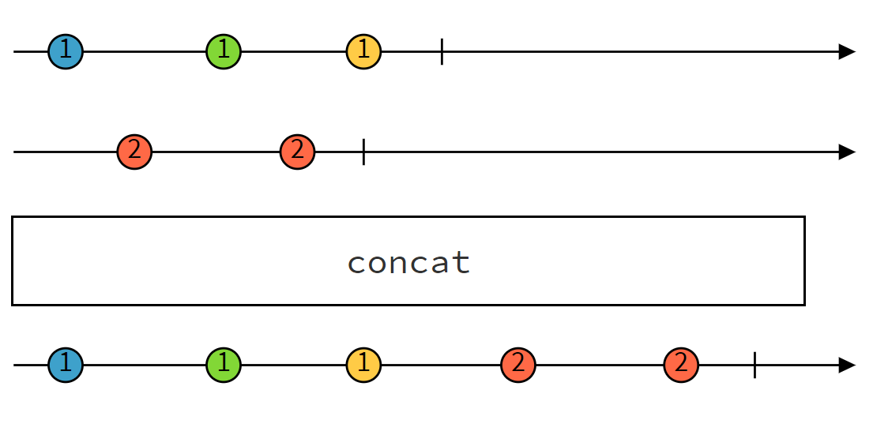
High-Level Operators
concat()

Slide 28
High-Level Operators
switchMap()

Slide 29

Thanks！

